Slide 1
TO THE LOCKDOWN ENGAGEMENT LEARNING PLATFORM
PRESENTED BY:
Mr. TIJANI IBRAHIM
ISCHOLARS INTERNATIONAL ACADEMY
WELCOMES
GRADE FIVE SCHOLARS

Slide 2
DATE : 22, April 2020. 29, Sha’aban 1441AH
SUBJECT : Information communication Technology (ICT)
Topic : REVISION OF SECOND TERM WORK

Slide 3
DO YOU STILL REMEMBER LAST TERM TOPICS
KEYBOARD
MOUSE
THE DESKTOP

Slide 4
IN THIS CLASS, WE WILL REVISE ON THE KEYBOARD

Slide 5
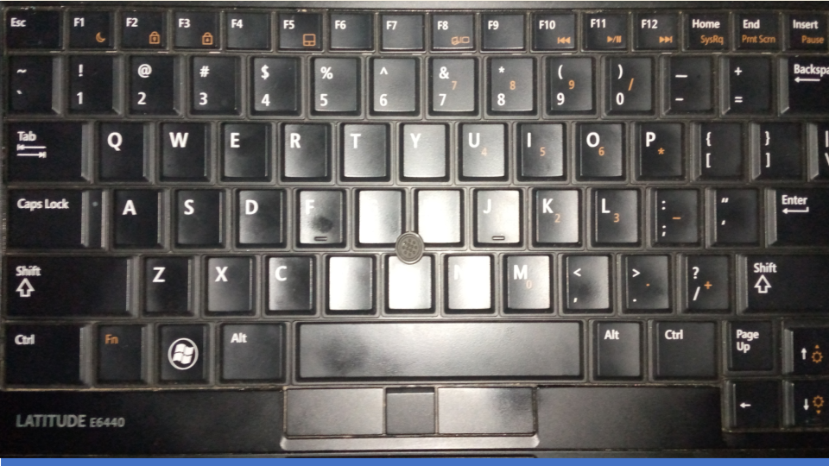
KEYBOARD KEYS
SO LET’S PLAY A GAME, I CIRCLE SOME KEYS YOU TELL ME WHAT KIND OF KEYS THEY ARE :

Slide 6
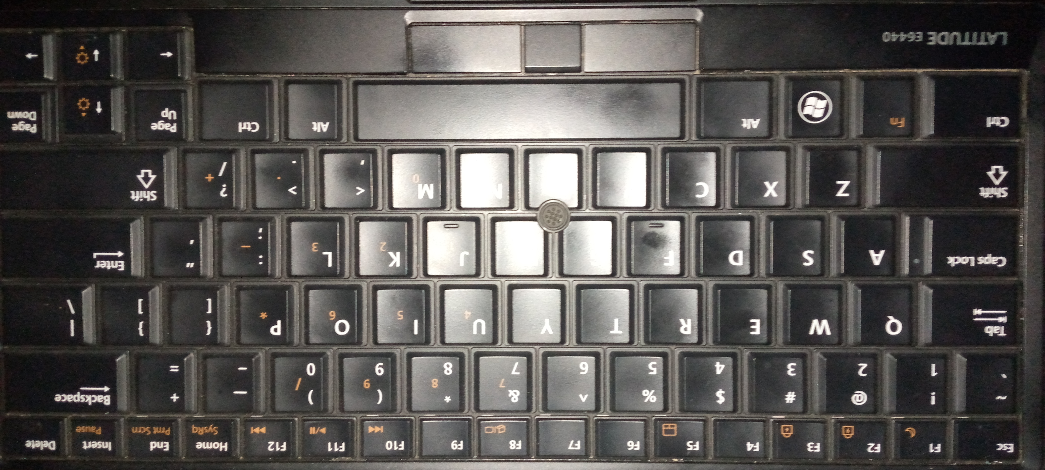
ALPHA-NUMERIC KEYS
SO LET’S PLAY A GAME, I CIRCLE SOME KEYS YOU TELL ME IF THE ARE
APLHANUMERIC

Slide 7
FUNCTION KEYS

Slide 8
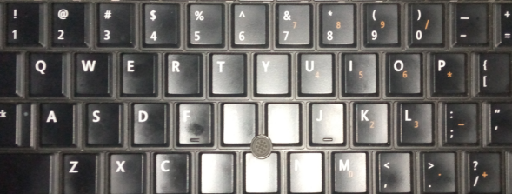
ALPHA-NUMERIC KEYS

Slide 9
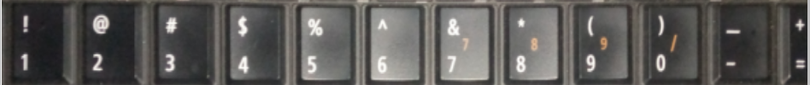
NUMERIC KEYS

Slide 10
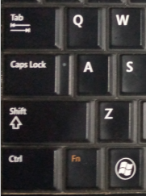
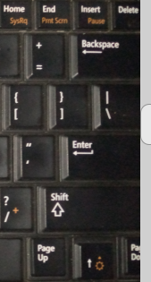
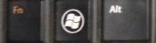
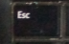
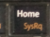
CONTROL KEYS

Slide 11
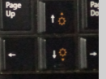
ARROW KEYS

Slide 12
ALHAMDULILLAH WE HAVE COME TO THE END OF THIS CLASS
SO I WILL GIVE YOU SOME EXERCISES TO HAVE FUN WITH, SO TAKE YOUR TIME TO DO THEM

